Slide 1
Creating a Query on the DB
CIS 265

Slide 2
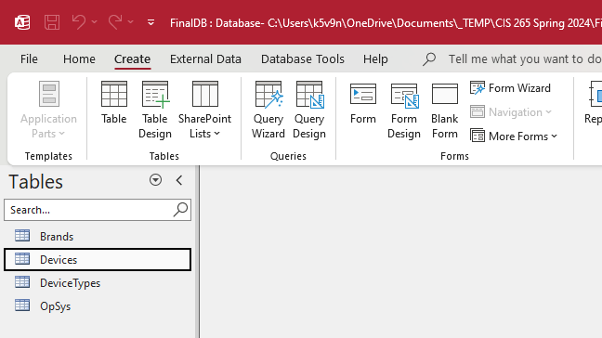

Slide 3
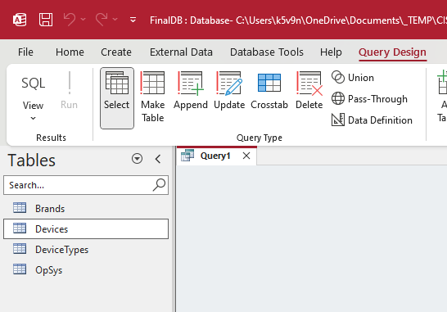

Slide 4
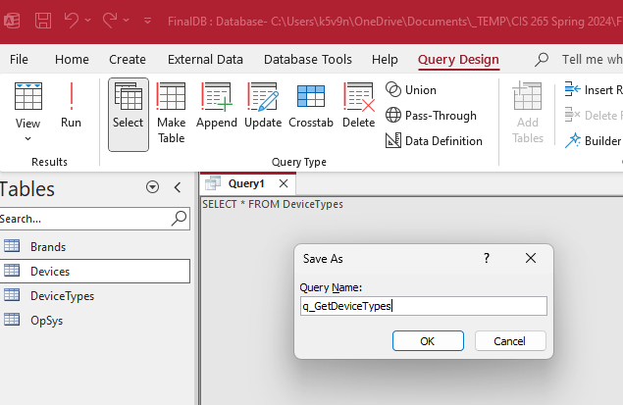
Type your Query and then click CTRL+S to save it with a meaningful name.

Slide 5
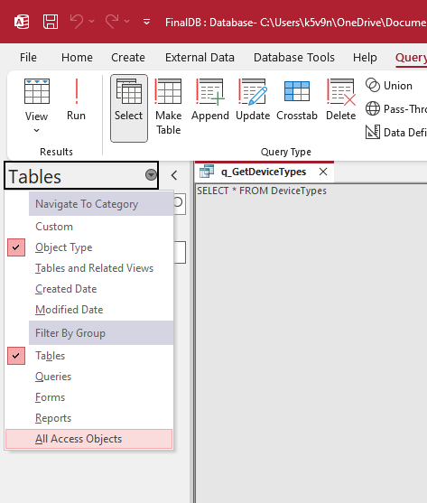
Click All Access Objects so your database shows you more than just the tables

Slide 6
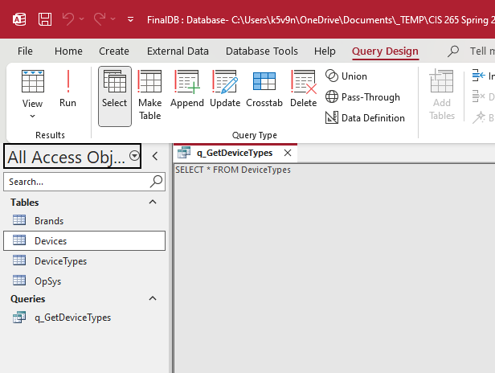
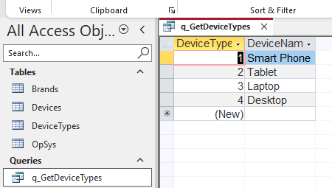
Double-click your Query so it displays the results and you can confirm it returns what you expect it to.

Slide 7
Code to execute a query stored on DB:
Dim cmd As New OleDbCommand("q_GetDeviceTypes", con)
cmd.CommandType = CommandType.StoredProcedure
con.Open()
' Execute the "stored procedure"
Using reader As OleDbDataReader = cmd.ExecuteReader()
' Loop through the results
While reader.Read()
' Do Stuff
End While
End Using
con.Close()

